Slide 1
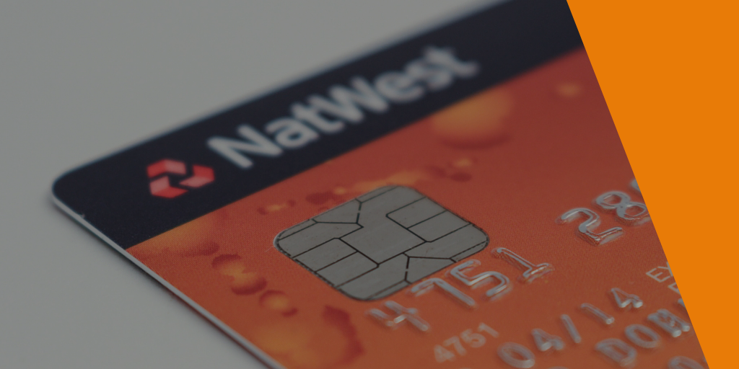
Credit Card Fraud Detection Approach Using Machine Learning
Bachelor of Science Special (Hons) in Information Technology Specialized in Software Engineering

Slide 2
MEMBER DETAILS
Student Name | Student No.
T.M.G.A.B. Thennakoon | IT15046512
H.G.S. Premadasa | IT15142610
C.B.P. Lochana | IT15111784
M.D.S. Mihiranga | IT15004550
Supervisor : Mr. Nuwan Kuruwitaarachchi
Co-Supervisor : Mr. Lakmal Rupasinghe

Slide 3
INTRODUCTION
With rapid development of electronic commerce the number of transactions by credit cards are increasing rapidly, therefore cases of transaction fraud are also increasing.
A credit card fraud is a wrongful or criminal deception aimed to bring ﬁnancial or personal gain.
In simple terms, Credit Card Fraud is defined as when an individual uses another individual’s credit card for personal reasons while the owner of the card and the card issuer are not aware of the fact that the card is being used.

Slide 4
Credit card fraud has been divided into two types; Offline fraud and Online fraud.
Offline fraud is committed by using a stolen physical card at call center or any other place.
Online fraud is committed via internet, phone, shopping, web, or in absence of card holder.

Slide 5
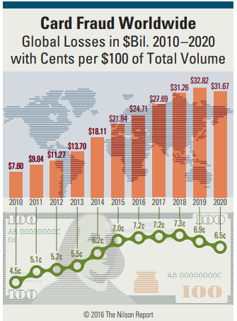
RESEARCH PROBLEM
Occurrence of fraud on credit cards make huge financial losses to both bank and card holder.
According to the Nilson Report in October 2016, more than $31 trillion were generated worldwide by online payment systems in 2015, increasing 7.3% than 2014.
Worldwide losses from credit card fraud rose to $21 billion in 2015, and will possibly reach $31 billion by 2020.

Slide 6
RESEARCH GAP
The state of art today and the approach we choose

Slide 7
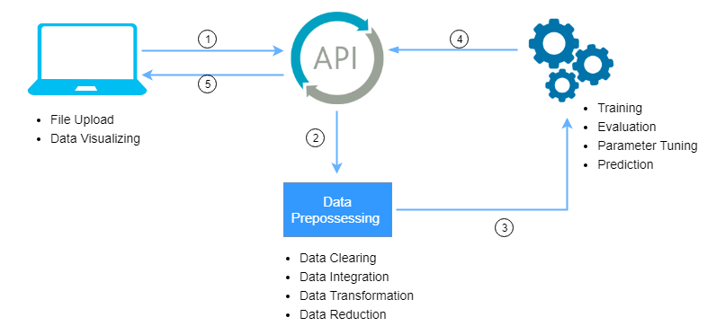
PROPOSED SOLUTION

Slide 8
ALGORITHMS USED
Support Vector Machine
Logistic Regression
Neural Networks
Decision tree

Slide 9


Slide 10
SUPPORT VECTOR MACHINE
text

Slide 11
LOGISTIC REGRESSION
text

Slide 12
NEURAL NETWORK
A neural network is a computer system modelled on the human brain and nervous system.
Neural networks, with their remarkable ability to derive meaning from complicated or imprecise data, can be used to extract patterns and detect trends that are too complex to be noticed by either humans or other computer techniques.
Adaptive learning
Self Organization.
Real Time Operation
Fault Tolerance via Redundant Information Coding.
Notes:
Adaptive learning: An ability to learn how to do tasks based on the data given for training or initial experience.
Self-Organisation: An ANN can create its own organisation or representation of the information it receives during learning time.
Real Time Operation: ANN computations may be carried out in parallel, and special hardware devices are being designed and manufactured which take advantage of this capability.
Fault Tolerance via Redundant Information Coding: Partial destruction of a network leads to the corresponding degradation of performance. However, some network capabilities may be retained even with major network damage.

Slide 13
As we said about NN we can recognize a pattern for frauds. From those patterns identify the frauds for given data set.

Slide 14
DECISION TREE
A Decision tree algorithms are a method for approaching discrete-valued target functions, in which the learned function is denoted by a decision tree. A decision tree structure is made of root, internal and leaf nodes.
Decision trees are recognized as very powerful and attractive classification tools, mainly because they produce easily interpretable and well-organized results and are, in general, computationally efficient and capable of dealing with noisy data.
Decision trees are generated by algorithms that split a dataset into multiple branching segments based on decision rules. These decision rules are determined by identifying a relationship between input attributes and the outputs.

Slide 15
How do we select algorithms for the model?
A Literature review will be done for the selected four algorithms.
Implementing the algorithm and the same data set will be used to train all four algorithm.
Output will be analyzed against selected features.
Accuracy
Efficiency
In addition, by using a set of data individual accuracy of each algorithm will be checked using a suitable procedure.

Slide 16
Implement fraud detection model
A Lit.

Slide 17
Data Preprocessing
Real-world data is often incomplete, inconsistent and is likely to contain many errors.
Data preprocessing is a proven method of resolving such issues by transforming raw data into an understandable format.
Steps - Data clearing.
Data integration.
Data transformation .
Data reduction.

Slide 18
Data Visualization
Data visualization is use to help people to understand the significance of data by placing it in a visual context.
t-SNE , Sammon mapping, Isomap, and Locally Linear Embedding are the techniques uses for data visualization.
t-Distributed Stochastic Neighbor Embedding (t-SNE) is a technique for dimensionality reduction that is particularly well suited for the visualization of high-dimensional datasets

Slide 19
Web Application
We provide a web application to the end user. By the web application user able to work with the API we provide.
Technologies
Develop the web application using JavaScript framework.
React JS use as the framework for the front end developments.
React JS features like server-side communication.

Slide 20
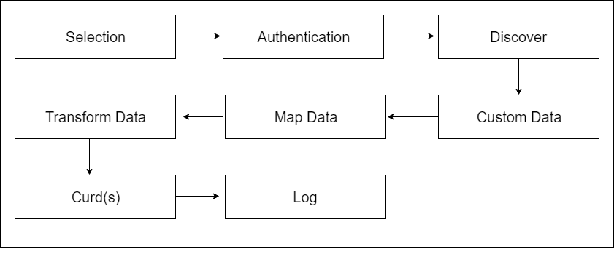
API Implementation

Slide 21
We have decided to use python for the algorithm and model implementation. Therefore most suitable language is python to implement an API. Eve is an open source Python REST API framework designed for human beings. It allows to effortlessly build and deploy highly customizable, fully featured RESTful Web Services.

Slide 22
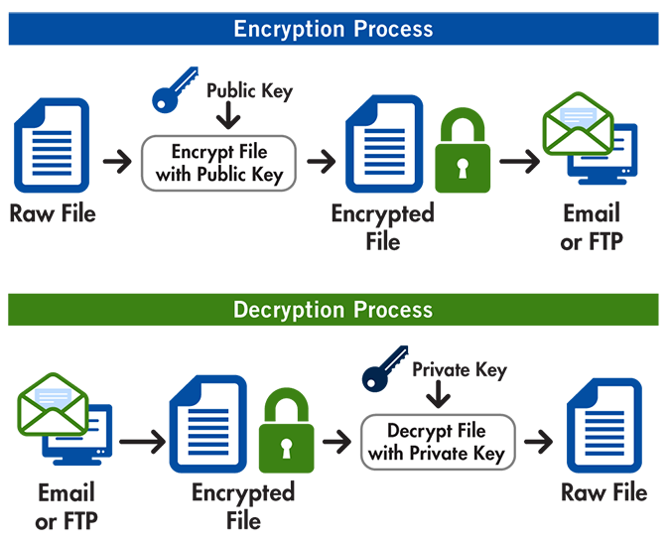
Data Encryption

Slide 23
Encryption is a way of keeping the data safe and confidential as it is sent over the internet.
We have decided to use International Data Encryption Algorithm(IDEA) to encrypt the raw data set.
End use can upload the raw data set and can add their own password. System will automatically encrypt the row data set and the user password.
For this process we provide a minified JS file to do the encryption. This minified JS file will be compatible for all front end languages.

Slide 24
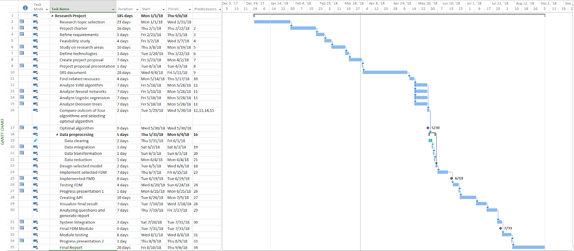
Gantt Chart

Slide 25
THANK YOU

